Slide 1
Line Coding Schemes
‏Line coding is the process of converting binary data, a sequence of bits to a digital signal.
Sujoy Mukherjee
sujoymukherjee@ieee.org

Slide 2
Definitions of the components/Keywords:
Binary data can be transmitted using a number of different types of pulses. The choice of a particular pair of pulses to represent the symbols 1 and 0 is called Line Coding.

Slide 3
Master Layout
Input Data
0 1 1 0 1 1 1 0 1 0 1
Digital Signal

Slide 4
Step 1:
unipolar NRZ (Non Return to Zero)
Representation of 0
Representation of 1
Instruction for the animator | Text to be displayed in the working area (DT)
The first fig should appear then the second fig should appear. In parallel to the figures the text should be displayed. | Bit 0 is mapped to amplitude close to zero Bit 1 is mapped to a positive amplitude A DC component is present

Slide 5
Step 2:
Polar NRZ (Non Return to Zero)
Representation of 0
Representation of 1
Instruction for the animator | Text to be displayed in the working area (DT)
The first fig should appear then the second fig should appear. In parallel to the figures the text should be displayed. | Bit 0 is mapped to a negative amplitude Bit 1 is mapped to a positive amplitude A DC component is present

Slide 6
Step 3:
Polar RZ (Return to Zero)
Representation of 0
Representation of 1
Instruction for the animator | Text to be displayed in the working area (DT)
The first fig should appear then the second fig should appear. In parallel to the figures the text should be displayed. | A bit 0 is mapped to a negative amplitude −A for the first half of the symbol duration followed by a zero amplitude for the second half of the symbol duration. A bit 1 is mapped to a positive amplitude +A for the first half of the bit duration followed by a zero amplitude for the second half of the bit duration.

Slide 7
Step 4:
NRZI (Non Return to Zero Inverted)
Representation of 0
Representation of 1
Fig. A Fig. B Fig. C Fig. D
Instruction for the animator | Text to be displayed in the working area (DT)
The first fig should appear then the second fig should appear. In parallel to the figures the text should be displayed. | Bit 0 mapped to no signal level transition Bit 1 is mapped to signal level transition at the beginning of the bit interval Assumption: The signal level to the left of the bit is high– Fig. A and Fig. C The signal level to the left of the bit is low – Fig. B and Fig. D

Slide 8
Step 5:
Manchester coding
Representation of 0
Representation of 1
Instruction for the animator | Text to be displayed in the working area (DT)
The first fig should appear then the second fig should appear. In parallel to the figures the text should be displayed. | Bit 0 is sent by having a mid-bit transition from high to low. Bit 1 is sent by having a mid-bit transition from low to high.

Slide 9
Step 6:
Differential Manchester coding
Representation of 0
Representation of 1
Fig. A Fig. B Fig. C Fig. D
Instruction for the animator | Text to be displayed in the working area (DT)
The first fig should appear then the second fig should appear. In parallel to the figures the text should be displayed. | Bit 0 is mapped to signal level transition at the beginning of the bit interval. Bit 1 is mapped to absence of signal level transition at the beginning of the bit interval. Assumption: The signal level to the left of the bit is high – Fig. A and Fig. C The signal level to the left of the bit is low – Fig. B and Fig. D

Slide 10
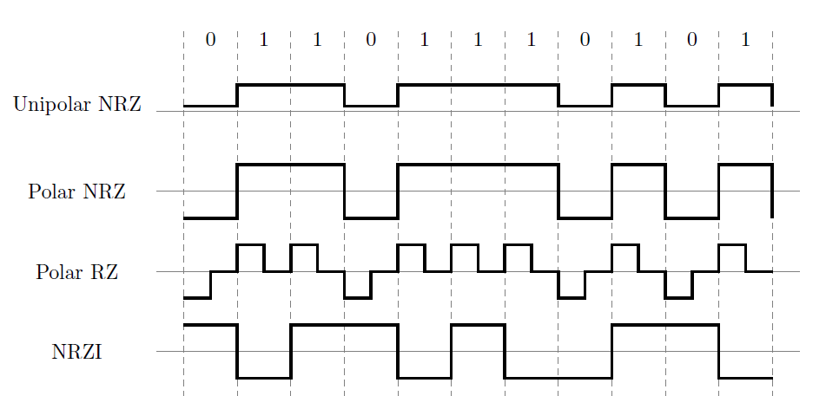
The corresponding waveforms should be shown in the demo part when a particular line code is selected.

Slide 11
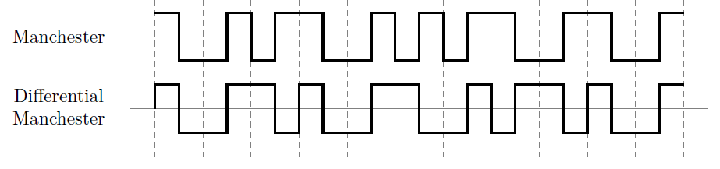
Illustration of different line coding schemes

Slide 12
Assumption:
The signal level to the left of the bit is high
Line coding Scheme | Representation of 0 | Representation of 1
Unipolar NRZ
Polar NRZ
Polar RZ
Include Slides 13 and 14 in the theory part

Slide 13
Line coding Scheme | Representation of 0 | Representation of 1
NRZI
Manchester
Differential Manchester

Slide 14
Links for further reading
Reference websites:
Books: “Communication Systems” by Simon Haykin, fourth Edition
“Data and Computer Communications” by William Stallings, eighth Edition
Research papers:

